Slide 1
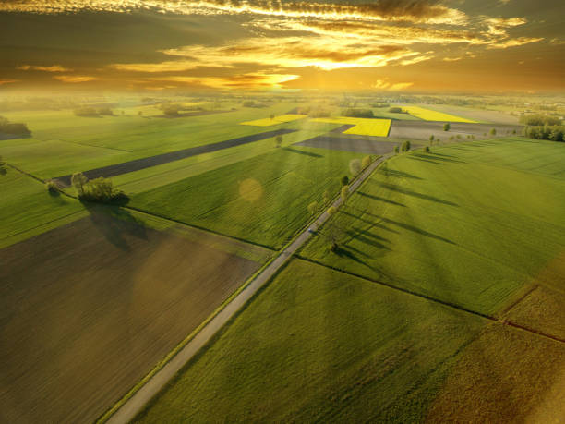



Slide 2





ReCrop Team
Jonathan
Dao
Erasmus Master Student at Politecnico di Milano from
ESIEE Paris
Daniele Giorgianni
Master Student in
Computer Science at
Politecnico di Milano
Luca Giudici
Master Student in
Computer Science at Politecnico di Milano
Leonardo
Giusti
Master Student in
Computer Science at Politecnico di Milano
Notes:
Hi everyone!
My name is Daniele and today I’m here with [others introductions...]

Slide 3
ReCrop Team
 | Jonathan | Luca | Daniele | Leonardo
Dataset Research |  | X | X | X
Pre Processing |  | X | X | X
Data Analysis for Classification |  |  |  | X
Classification models | X |  |  | X
Data Analysis for Clustering |  | X |  | X
Clustering models |  | X | X | X
Data Analysis for Regression | X |  |  | X
Regression models | X | X | X
Presentation |  | X | X
Notes:
This is a table to represent how we split the various tasks.
However, the workload was distributed equally

Slide 4

Our Idea
Problems
Climate Changes
Uncertainty on Resources Availability
MARCO
Notes:
Our idea started analyzing these 2 main problems that can affect a farmer:
Climate changes (like increasing temperatures, unseasonal rains, and so on…)
Uncertainty of resources (like fertilizers or seeds)

Slide 5

Our Idea
How do I choose what to plant considering these factors
Problems
Climate Changes
Uncertainty on Resources Availability
MARCO
Notes:
These problems can lead a farmer to ask himself:
How do I choose what to plant considering these factors?

Slide 6
Our Idea
How do I choose what to plant considering these factors
Problems
Climate Changes
Uncertainty on Resources Availability
ReCrop
Best Crops Recommendations on Environmental Basis
Estimated Economic Revenue for Suggested Crops
MARCO
Notes:
Trying to replay to this question we came out with ReCrop, our idea to provide to farmers like Marco:
The best crops he can plant given his soil and environmental conditions
Estimating how much he can produce and earn from our suggestions
Surfing online we found this…

Slide 7
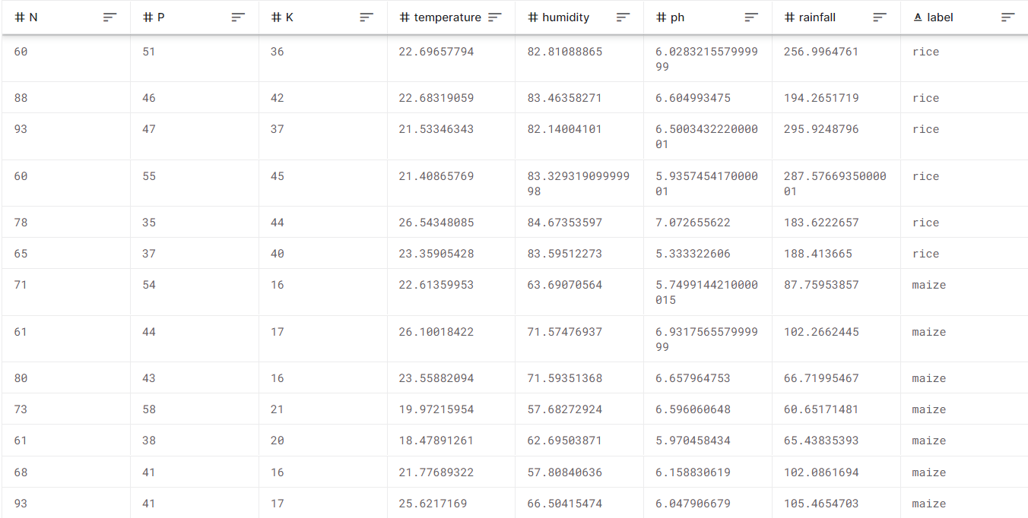
Too Nice To Use
2.2k tuples

Slide 8
Too Nice To Use
2.2k tuples
But analyzing it...

Slide 9
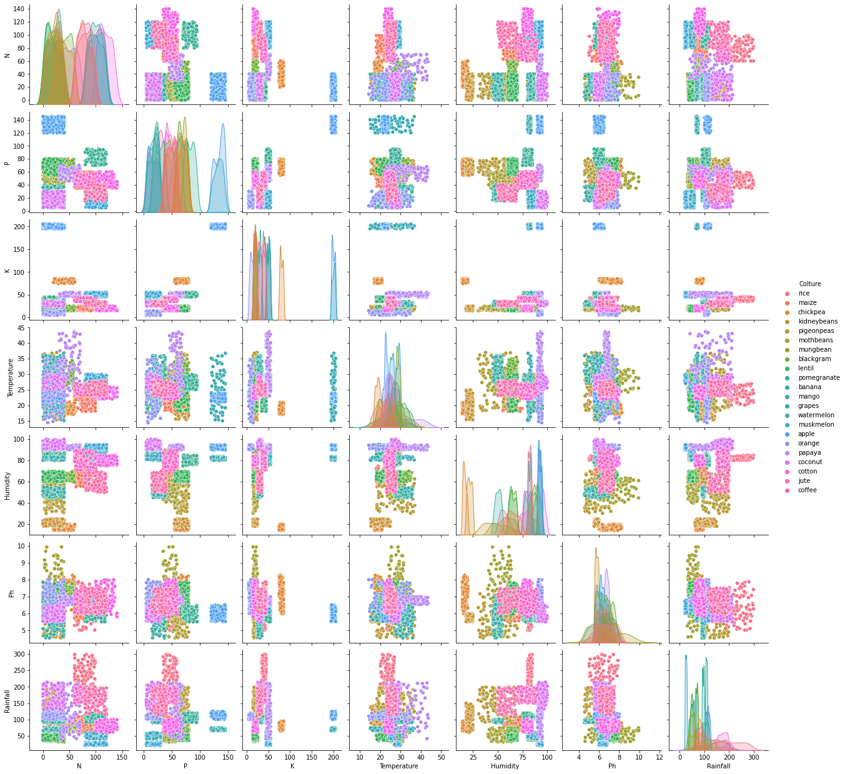
Too Nice To Use
But analyzing it...
Clusters were already there

Slide 10
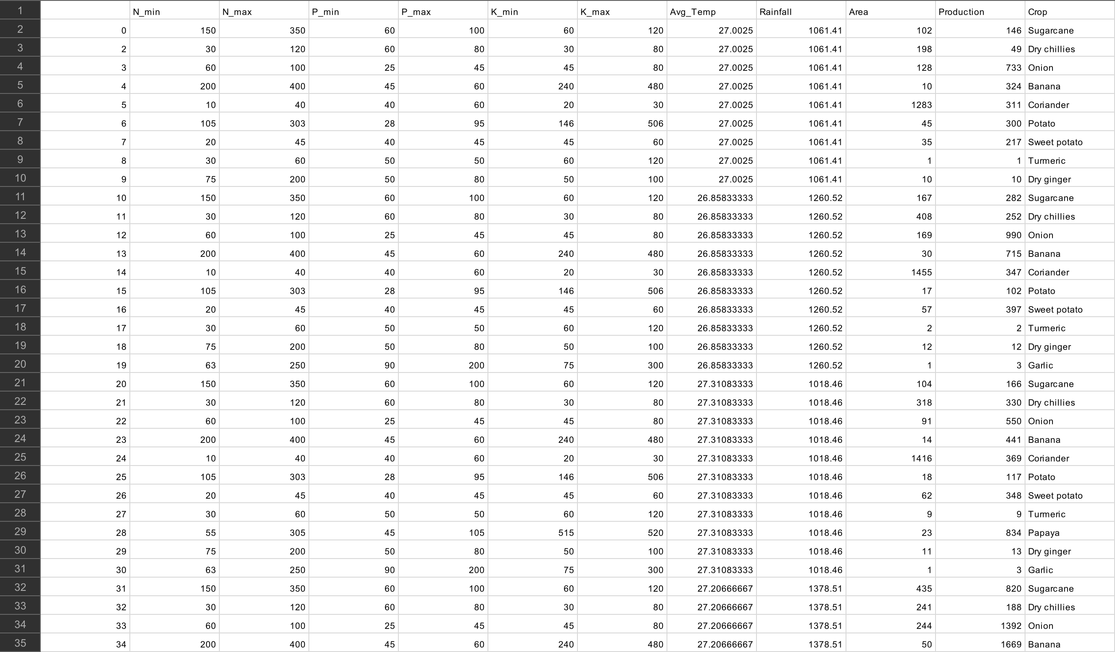
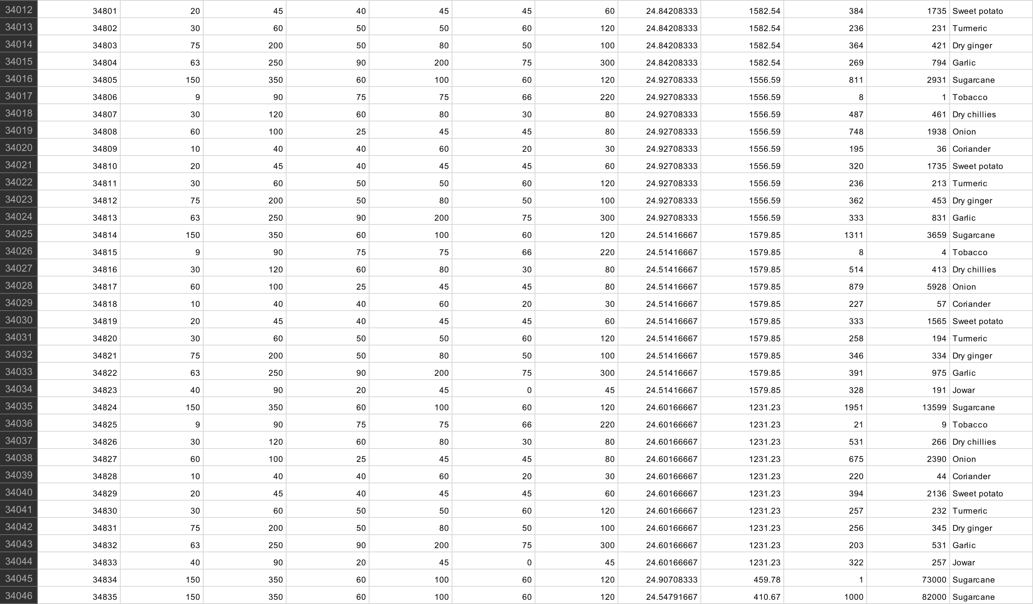


Our Own Dataset
Notes:
And that’s why we decided to create our own dataset starting from ICRISAT and some literature.
From ICRISAT (a sort of Indian ISTAT) we collected data over some productions Areas, its Average Temperature, Rainfall, tons of Production and the relative crop
From the literature we collected the ranges of Nitrogen, Phosphorous and Potassium recommended for all the crops we have.

Slide 11
Our Own Dataset
+34k tuples
Important data to provide farmers with a tool to:
Compare what they have done so far
Choose their next crop to plant more consciously
Notes:
By doing so we were able to a dataset with more than 34k tuples to prove our idea and offering to framers a tool for:
Comparing what they have done with what they could have done, and
Choosing more consciously their next crop to plant

Slide 12
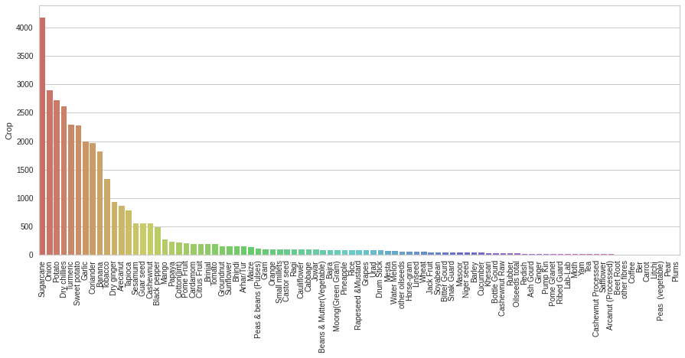
Data Analysis

Slide 13
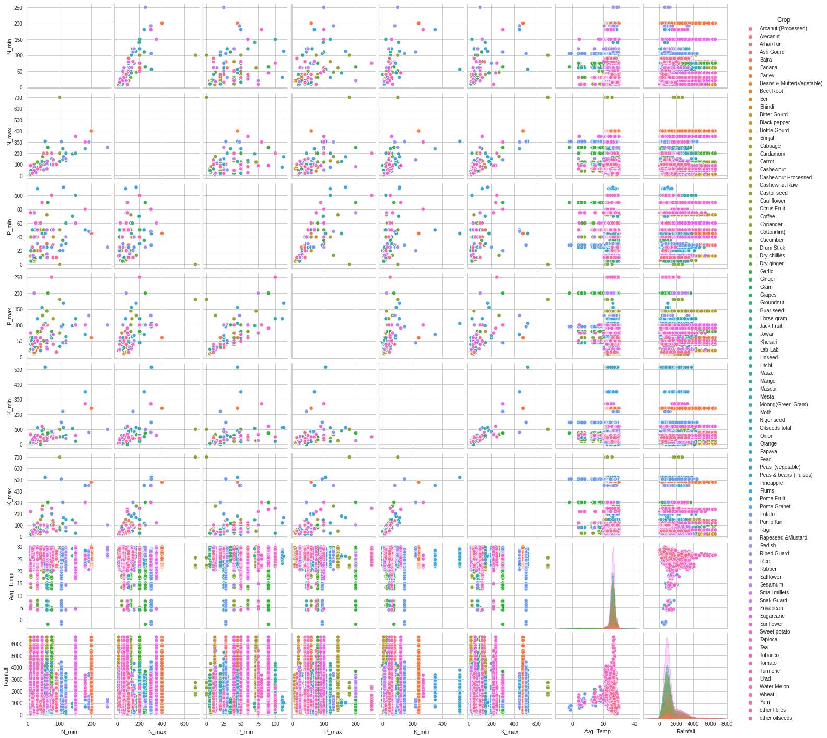
Feature Analysis

Slide 14
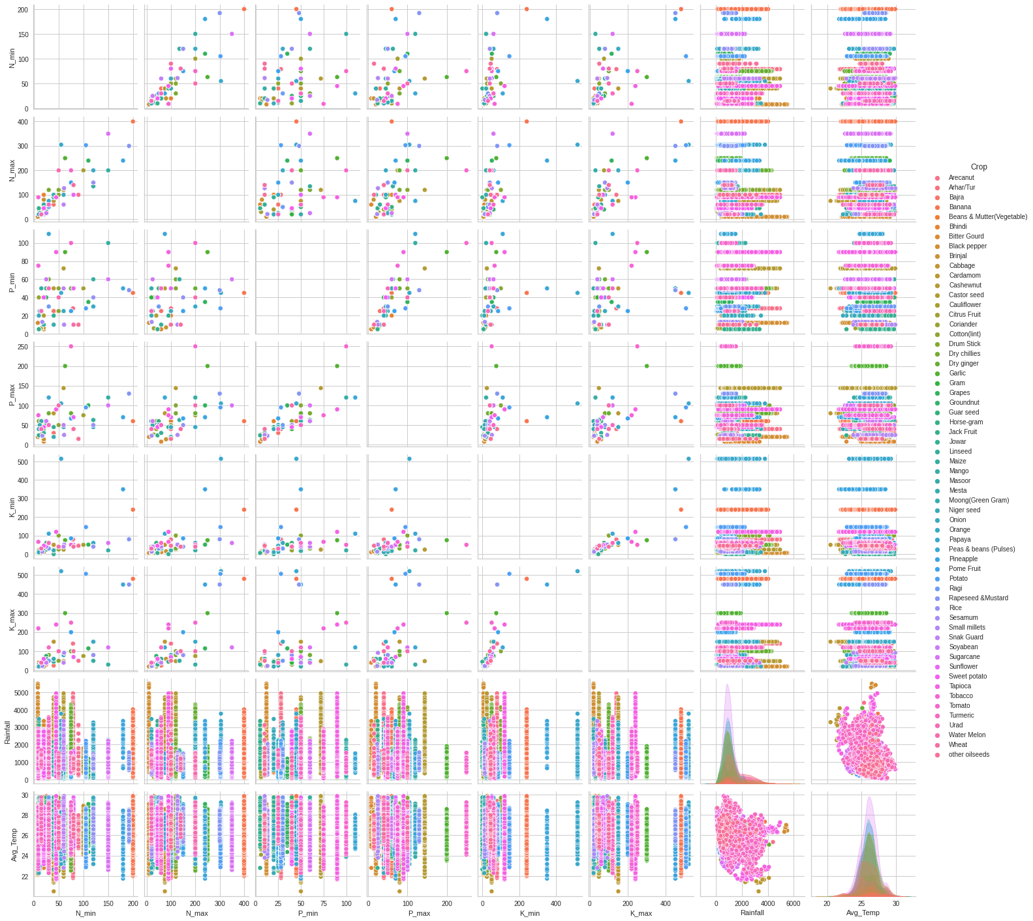
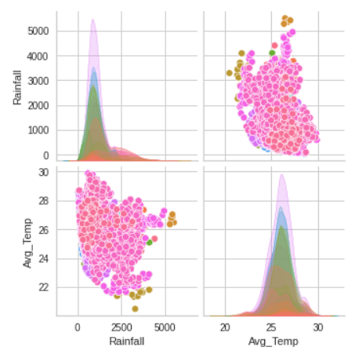
Our dataset

Slide 15
What To Do with this New Dataset
We want to suggest the best crops that fits the best the environmental conditions and use of fertilizers
For the same conditions it would be possible to plant different type of crops so...
… we've classified them by grouping into clusters
We've used different and mixed techniques to see and compare different results
Data normalization
PCA
Agglomerative Clustering
K-means
Notes:
After Leonardo analysis and cleaning, we’ve decided to perform clustering on this new dataset. Why clustering? Because, based on our idea, we want to find which crops are grown for the same environmental conditions and fertilizer usage, so with a cluster analysis we can classify and understand our data a little bit more

Slide 16
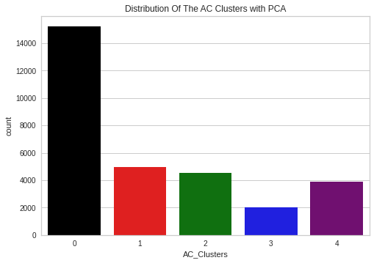
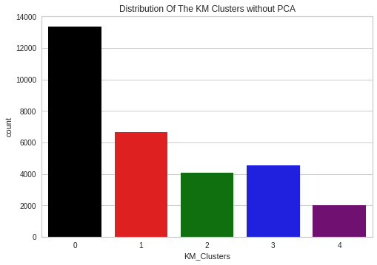
Clustering
w/ and w/o PCA
AC w/ PCA
KM w/o PCA
Notes:
We’ve decided to do an analysis with and without the Principal Component Analysis for 2 algorithms, Agglomerative Clustering and K-means.
Analyzing the results we’ve seen that these 4 models in total have very similar results so we take as an example for this presentation only Agglomerative Clustering with PCA and K-means without PCA.
The PCA has been used to reduce the dimensions from 8 features to 3.
To determine the number of clusters to form we’ve used the Elbow Method and for these models the number of clusters is 5.
As we can seen on these histograms, these 2 approaches have no big differences in regarding the number of crops per cluster.

Slide 17
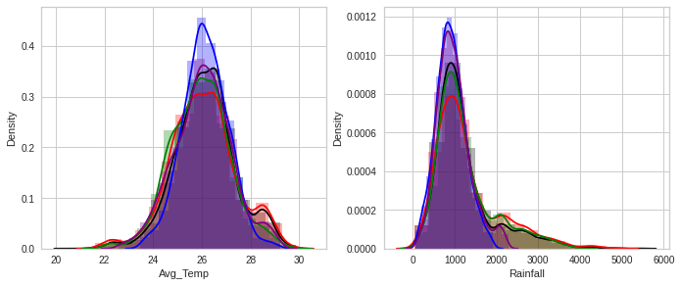
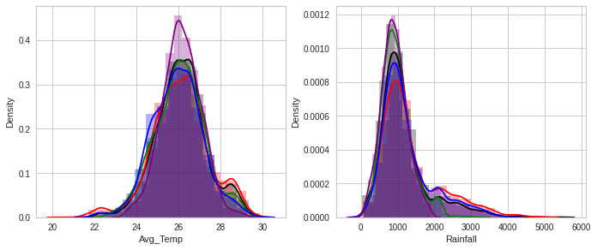
Clustering
w/ and w/o PCA
AC w/ PCA
KM w/o PCA
The distribution graphs for Temperature and Rainfall clearly shows that for each cluster, in both cases, the crops are almost equally distributed.
Notes:
Looking at the features used for the clustering we’ve noticed that for temperature and rainfall all the clusters are almost equally distributed as in the slide. So we can conclude that these 2 features don't really impact the clusters.

Slide 18
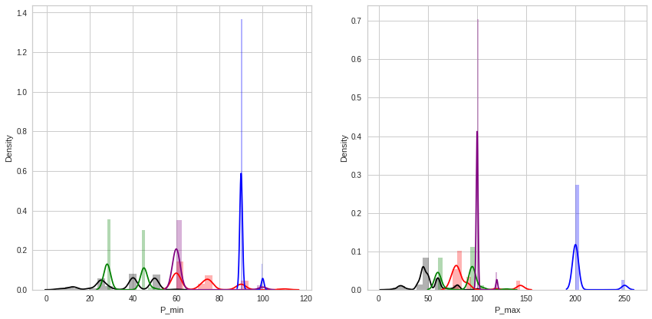
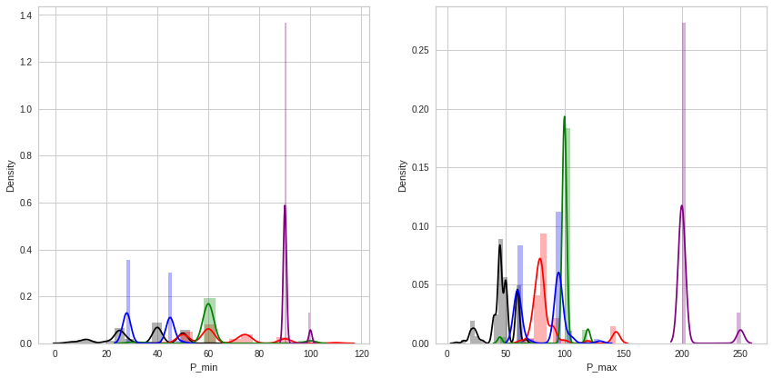
Clustering
w/ and w/o PCA
AC w/ PCA
KM w/o PCA
The distribution graphs for minimum Phosphorous and maximum Phosphorous shows that, for each cluster, in both cases, a cluster is defined by the values of this two features.
Notes:
What really makes the difference are the NPK values.
In the slide, it is only reported the Phosphorous, as an example, but for nitrogen and potassium we’ve similar results. We’ve understood that the clustering method takes in considerations mostly the features relative to the use of NPK.

Slide 19
Clustering Crops per KM w/o PCA
Cluster 0
Cluster 2
Turmeric, Coriander, Onion, Ragi, Black pepper, Linseed, Urad, Citrus Fruit, Sweet potato, Arecanut, Bitter Gourd, Guar seed, Bhindi, Sesamum, Cotton(lint), Jowar, Castor seed, other oilseeds, Pome Fruit, Arhar/Tur, Niger seed, Gram, Cabbage, Moong(Green Gram), Groundnut, Rice, Snak Guard, Small millets, Wheat, Bajra, Beans & Mutter(Vegetable), Soyabean, Mesta, Jack Fruit, Horse-gram, Masoor
N (25-60) - P (40-50) - K (45-70) kg/ha
Tobacco, Dry chillies, Dry ginger, Tapioca, Cashewnut, Cardamom, Sunflower, Cauliflower, Peas & beans (Pulses), Brinjal, Maize, Watermelon, Drumstick
N (150-350) - P (60-100) - K (60-120) kg/ha
Cluster 3
Potato, Banana, Papaya, Rapeseed &Mustard, Pineapple
N (105-303) - P (30-100) - K (145-505) kg/ha
Cluster 1
Cluster 4
Sugarcane, Grapes, Mango, Orange
N (30-120) - P(60-80) - K (50-90) kg/ha
Garlic, Tomato
N (60-250) - P(90-200) - K(75-300) kg/ha
Notes:
And these are the clusters. First thing to notice is that each crop belongs only to one cluster, there are no overlaps. Based on what we've said before before, we can see that each crop belongs to a cluster based on the interval between the NPK values between min and max.
Just to make an example, in cluster 3 we have the bananas that shares with the other crops in the cluster high values for potassium.

Slide 20
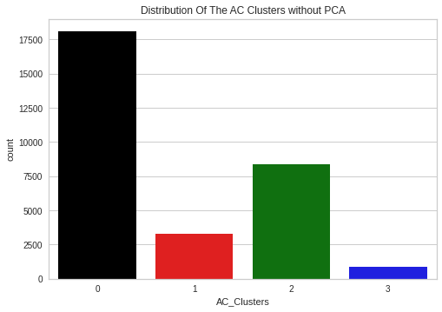
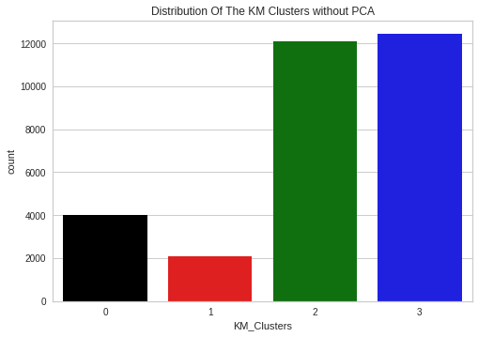
Clustering
only on Temperature and Rainfall
AC
KM
Notes:
Since the values of NPK we have come from the literature, we've also tried to cluster only on actual data of rainfall and temperature.
To make comparison with the previous result we’ve used once again the Agglomerative Clustering and K-means algorithms.
Of course in this case, since there are only 2 features, we didn’t have to perform the Principal Component Analysis.
First thing to notice is that the number of clusters is 4 instead of 5, using as before the Elbow Method to determine the number of clusters.
On the left we have a cluster that has a bigger number of values in it compared to the others, but on the right the distribution is better spread.
Analyzing them more deeply we understand why there are these differences.

Slide 21
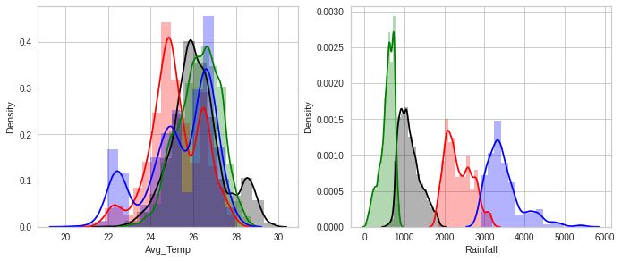
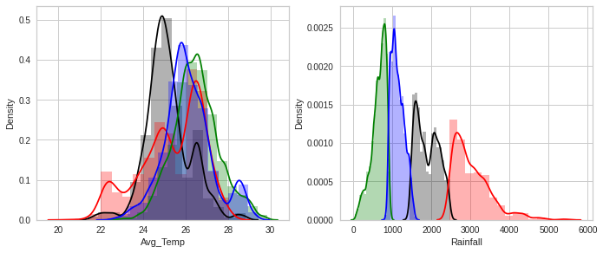
Clustering
only on Temperature and Rainfall
AC
KM
The distribution graphs for average temperature and rainfall shows that for each cluster, in both cases, the main feature that defines the cluster is the rainfall.
Notes:
Our dataset has the most number of tuples with rainfall between 500 and 1500 mm so this is the reason why for the previous left one histogram we've had the most of the values in the black cluster and in the right one we have that the blue and green cluster has almost the same number of values.
From these graphs we can also notice that the main feature used for the clustering is the rainfall.

Slide 22
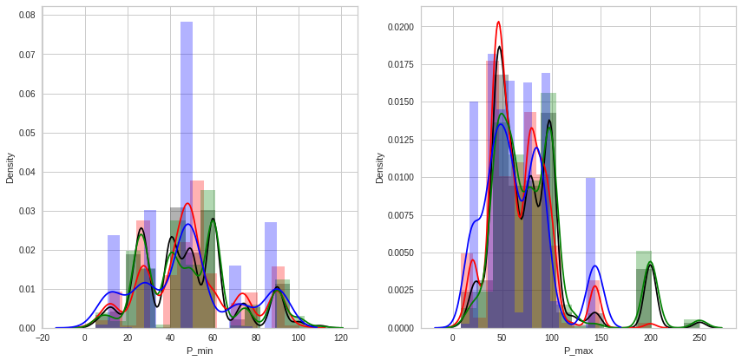
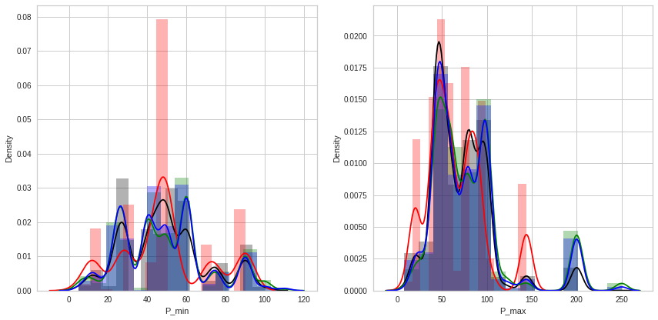
Clustering
only on Temperature and Rainfall
AC
KM
The distribution graphs for minimum Phosphorous and maximum Phosphorous shows that, for each cluster, in both cases, this two features are almost equally distributed.
Notes:
We've also tried to see if there was some correlation between the NPK values clustered over only the environmental conditions, but, as we can see, always on phosphorus as an example, there are no clear differences between the clusters. The only interesting thing that we can notice is on the value of 150 and 200 in the phosphorus max but it wasn't enough to justify a clear correlation between the features of NPK for a cluster.

Slide 23
Clustering
only on Temperature and Rainfall - Crops per KM
Cluster 0
Cluster 2
Pineapple - 55.813953 %
Drumstick - 32.857143 %
Tapioca - 29.518856 %
Arecanut- 28.192771 %
Snak Guard - 26.086957 %
Temperature 29.9 °C - Rainfall 1860 mm
Guar seed - 90.166976 %
Grapes - 84.000000 %
Citrus Fruit - 75.543478 %
Pome Fruit - 73.015873 %
Beans & Mutter(Vegetable) - 67.857143 %
Temperature 26.5 °C - Rainfall 695 mm
Cluster 1
Cluster 3
Black pepper - 47.461369 %
Cardamom - 44.845361 %
Tapioca - 36.671001 %
Arecanut - 33.975904 %
Pineapple - 33.720930 %
Temperature 25.5 °C - Rainfall 2910 mm
Ragi - 72.043011 %
Urad - 71.794872 %
Moong(Green Gram) - 68.965517 %
Groundnut - 68.243243 %
Small millets - 67.346939 %
Temperature 26 °C - Rainfall 1113 mm
Notes:
These are the clusters obtained with the K-means algorithm, similar results for agglomerative clustering. The main difference compared to what we've seen before is that there is an overlap per crop over different clusters, that's why the values are reported as a percentage. For example we can see that cluster 0 and cluster 1 share Tapioca and Areca Nut for an important percentage over the total but have a significant difference in the average temperature and rainfall characteristics values.

Slide 24
Regression: Why?
Once that Clustering is performed, we can train one regression model per cluster to predict a given crop's yields.
This prediction will show farmers an estimation on how much money they can earn after changing crops.
Regression predictions can be shown as part of a demonstration to show to potential customers how our business model works, and how useful our tool is.
To perform regression, we used Random Forests and Gradient Boosting techniques.
Notes:
We've obtained different clusters and know Jonatan will explain to you what we've done for the regression part over them.

Slide 25
Regression: Challenges
Very noisy dataset, even within clusters
Very sparse target values and not enough features: too many factors that influence crop yield prediction
A serious need to use more tools to produce accurate predictions

Slide 26
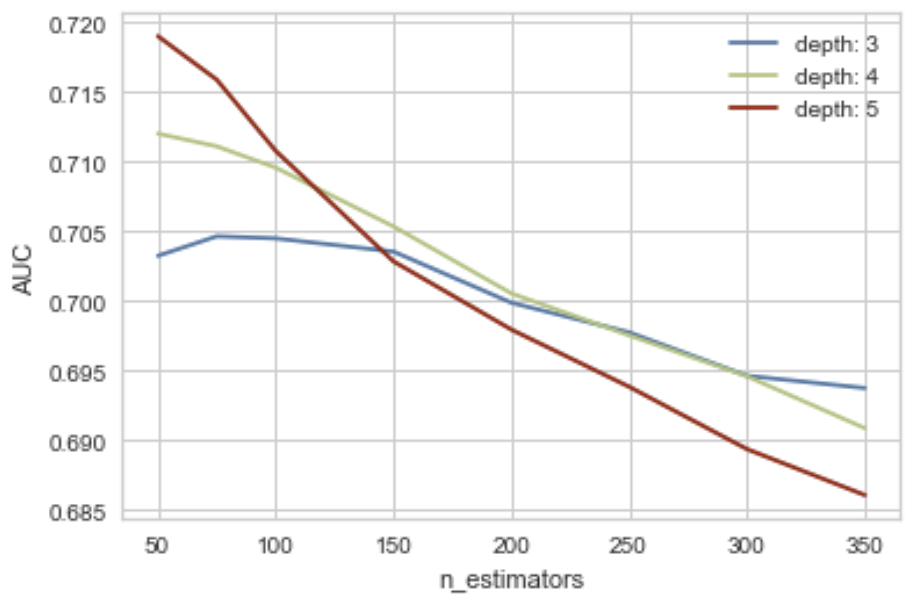
Model AUC with respect to the number of estimators

Slide 27
Regression: Results
Validation and grid search on Cluster 2
Performance of the same model on Tapioca: R2 = 0.75

Slide 28
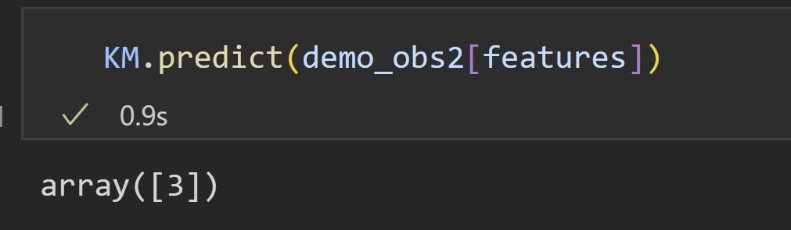
Prediction On Real Data
What can I plant in my soil with these conditions
Marco's input
N: 90 [kg/ha]
P: 108 [kg/ha]
K: 36 [kg/ha]
Average Temperature: 27 [°C]
Rainfall: 1163 [mm]
Area: 18901 [ha]
Clustering output:
MARCO

Slide 29
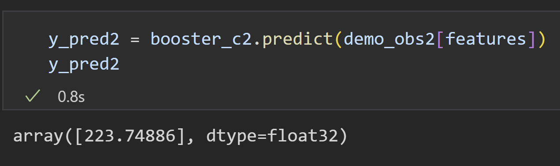
Prediction On Real Data
How much could I produce
Regression on Marco's input:
Ivory Coast Cashew productivity: 606 [kg/ha]
MARCO

Slide 30
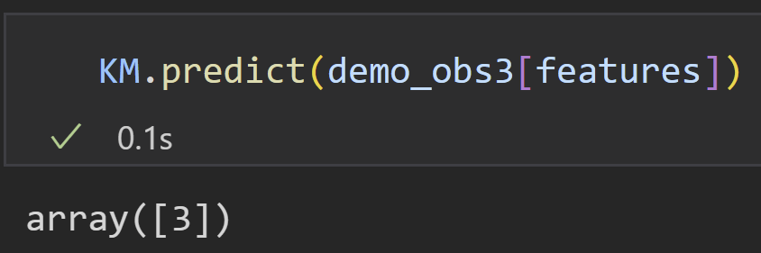
Prediction On Real Data
What can I plant in my soil with these conditions
Marco's input
N: 150 [kg/ha]
P: 62.5 [kg/ha]
K: 62.5 [kg/ha]
Average Temperature: 28 [°C]
Rainfall: 824.46 [mm]
Area: 276 [ha]
Clustering output:
MARCO

Slide 31
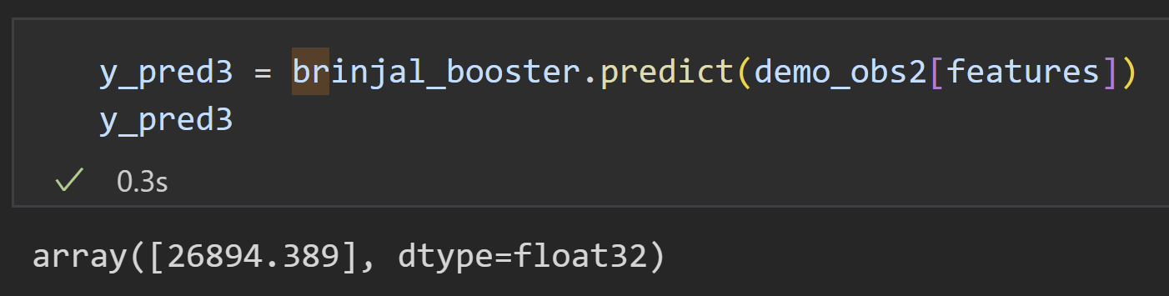
Prediction On Real Data
How much could I produce
Regression on Marco's input:
Italy Brinjal productivity: 38750 [kg/ha]
MARCO

Slide 32
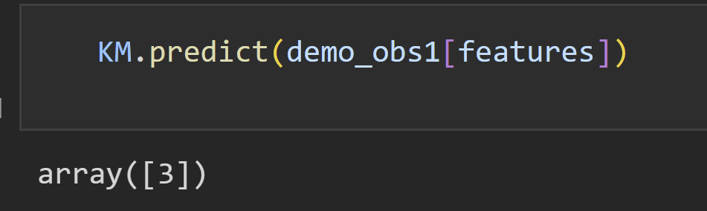
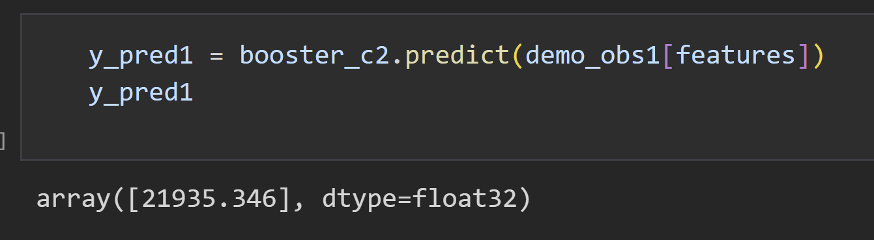
Prediction On Real Data
Feature values:
N min: 45 [kg/ha]
P min: 90 [kg/ha]
N max, P max: 90 [kg/ha]
K min: 120, K max: 240 [kg/ha]
Average temperature: 27 [°C]
Rainfall: 1112.22 [mm]
We decide to predict tapioca yields, as tapioca is in the third cluster.
Tapioca yield in Thailand from 2015 to 2016: 23,4375 [kg/ha]
ReCrop’s output:
Cluster n.3
Regression output:

Slide 33

"Prediction" On Italian Data
Is Mango a good choice
Marco's input
N: 150-200 [kg/ha]
P: 100-120 [kg/ha]
K: 20-30 [kg/ha]
Average Temperature: 18.6 [°C]
Rainfall: 850 [mm]
Area: 13 [ha]
MARCO
Notes:
We also tried an Italian use case with Marco, as a Mango producer in Sicily
He can ask to himself “Is Mango a good choice?”
Well…

Slide 34
"Prediction" On Italian Data
Is Mango a good choice
ReCrop’s output
Cluster n.1
Crops
Sugarcane
Grapes
Orange
Production ?
With more data we would be able to compare the productions and answer to Marco
MARCO
Notes:
We are not able to predict accurately the production for plants in Italian environmental conditions, because Indian data we based on have significantly different values compared to ours.
But this doesn't mean we are not able to help Marco to reply his question…

Slide 35

"Prediction" On Italian Data
Is Mango a good choice
ReCrop’s output
Cluster n.1
Crops
Sugarcane
Grapes
Orange
Production ?
With more data we would be able to compare the productions and answer to Marco
MARCO
WE NEED MORE "OIL"
Notes:
We simply need more data, more country data.
So…

Slide 36
"Prediction" On Italian Data
Is Mango a good choice
"Help us in collecting more data, and ask to your colleagues to do the same, and we will be able to answer to you very soon dear Marco!"
MARCO
Notes:
We need to invite farmers as Marco to collect that data so that we can help them with their questions.

Slide 37
What’s Next for ReCrop
Improvements
Get more information for more accurate predictions (for example using drones and satellite images)
Get more soil data with accurate analysis
Create datasets by country, inviting farmers to share data for their own benefit
Other areas ReCrop could work in
Yield forecasting for food security
Crop suggestion for urban farmers

Slide 38
Key Points Recap
ReCrop’s data
Soil/Fertilizer conditions (N, P, and K)
Weather conditions (temperature and rainfall)
Land area
ReCrop’s offer
Best crops to plant given environmental data
Estimated production for suggested crops
Comparison metrics for production
Zero-impact planting-harvesting simulation
Notes:
Before concluding I’d like to wrap up quickly what we have seen so far…
ReCrop need data of:
- Soil and Fertilizer conditions
Weather conditions and
Area extension
To offer:
The best crops given these environmental data
A production estimation for the suggested crops
This can be used in a comparative way
The entire idea can be seen as a zero-impact planting-harvesting simulator

Slide 39
Thank you for your attention
Any questions are welcome

